Slide 1
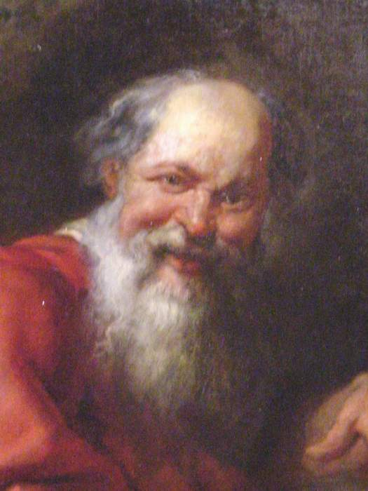
ATOMIC STRUCTURE
Democritus (460 – 370 BC)
Was the first person to come up with the idea of atom
Believed that all matter was composed of indivisible particles he called “ATOMS”
Which is derived from the Greek word “Atomos” – meaning indivisible
He also believed that different atoms:
Are different sizes
Have different properties
Other philosophers of that time did not agree with his theories.

Slide 2
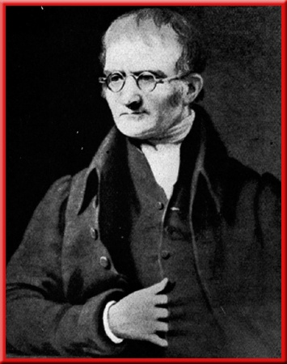
ATOMIC STRUCTURE
John Dalton (1766-1844) is the “Father of Atomic Theory”. Dalton’s Atomic Theory (1803) consists of five postulates:
All matter is comprised of extremely small particles called atoms (I agree with Democritus!).
All atoms of the same element are identical, having the same size, mass and chemical properties (almost true – isotopes).
All atoms of different elements are different.
Atoms cannot be created, destroyed (Conservation of Mass) or divided into smaller particles (in chemical reactions they are merely rearranged. We now know that they can be divided).
Atoms combine in definite whole-number ratios to make compounds (Laws of Constant Composition & Multiple Proportions).

Slide 3
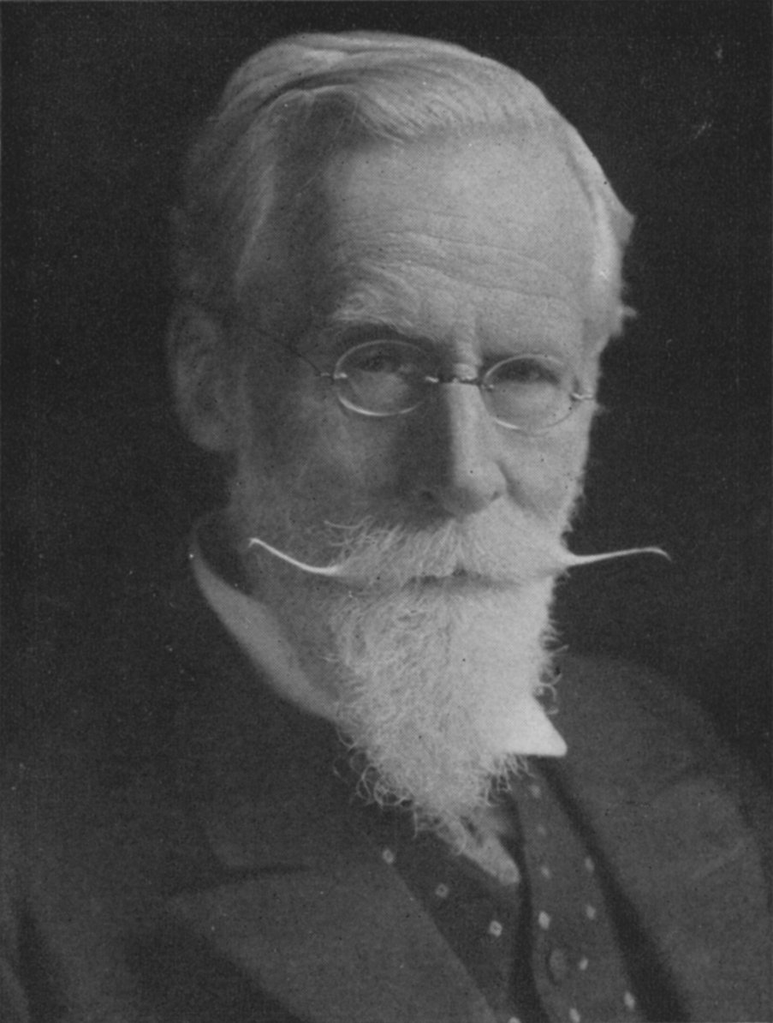

ATOMIC STRUCTURE
J.J. Thomson (1856-1940) used cathode rays to prove that Dalton’s Solid-ball model could be broken into smaller particles.
A cathode ray is a tube that has a piece of metal, called an electrode, at each end. Each electrode is connected to a power source.
When the power is turned on, the electrodes become charged and produce a stream of charged particles. They travel from cathode, across the tube to the anode.
Thomson is credited with discovering electrons.

Slide 4
ATOMIC STRUCTURE
-----------------------------
Thomson put the tube in a electric field. He predicted that the stream would travel in a straight path.
Instead, he found that the path curved away from a negatively charged plate and toward a positively charged plate
Why?
++++++++++++++
Like charges repel each other, and objects with unlike charges attract each other; Thomson concluded that the stream of charged particles had electrons in them. Thompson Concluded that cathode rays are made up of invisible, negatively charged particles called Electrons. These electrons had to come from the matter (atoms) of the negative electrode. Since the electrodes could be made from a variety of metals, then all atoms must contain electrons!

Slide 5

ATOMIC STRUCTURE
Thomson’s Plum Pudding model is a positively charged sphere that has negatively charged electrons scattered inside, like “raisins” in “plum pudding”.
Overall, the atom is neutral atom because the atom had the same number of positive and negative charges.
From Thomson’s experiments, scientists concluded that atoms were not just neutral spheres, but somehow were composed of electrically charged particles.
The balance of positive and negative charge supports the neutral atom.

Slide 6
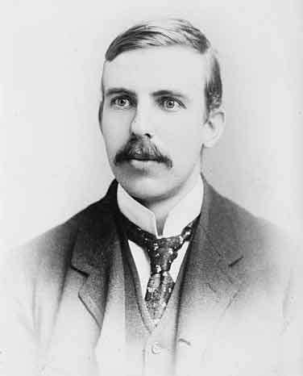
ATOMIC STRUCTURE
Ernst Rutherford (1871-1937) took Thomson’s Plum Pudding Model and added to it
Used the “Gold Foil Experiment” to discover the existence of:
An Atomic Nucleus
Protons (in later experiments)
In the Gold Foil Experiment, Rutherford directed a narrow beam of alpha particles (positive charges) at a thin piece of gold foil.
Based on observations from other experiments involving alpha particles, he predicted that the positive charges would go through the foil.

Slide 7
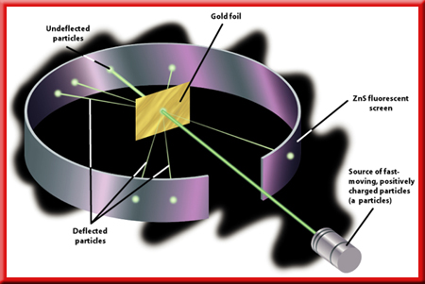
ATOMIC STRUCTURE
Rutherford found that every once and a while, a positive particle was deflected bounced back. (about 1% of the time)
Why? Because the positive charge hit a central mass of positive charge and was repelled.

Slide 8
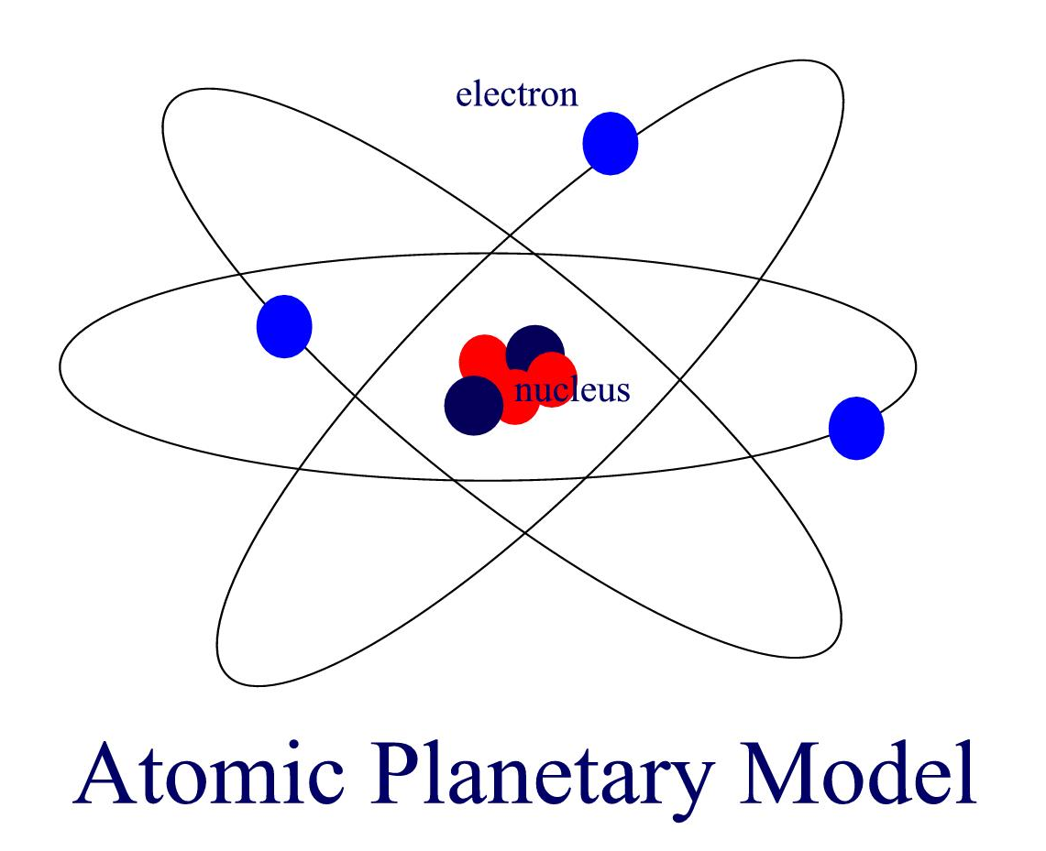
ATOMIC STRUCTURE
To explain these observations, Rutherford developed an updated model of the atom:
The atom contains a positively charged “nucleus”.
This nucleus contains almost all of the mass of the atom, but occupies a very small volume of the atom.
The negatively charged electrons occupied most of the volume of the atom.
The atom is mostly empty space.
The electrons orbit the nucleus like the planets revolve around the sun.

Slide 9
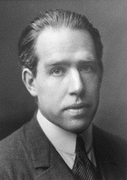
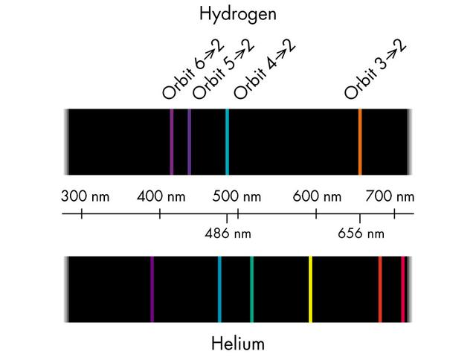
ATOMIC SPECTRA
This is Neils Bohr. He observed light using a spectrophotometer, which splits up the emitted light into separate frequencies.
He noted that Hydrogen gave off light only of specific frequencies.

Slide 10
ATOMIC SPECTRA
According to Planck’s equation (E = hf), each of these bands (frequencies) corresponds to a certain photon energy, meaning that the energized Hydrogen released this energy in specific sized bursts.
Bohr formulated the famous “Energy Level Planetary Model” of the atom from his observations.

Slide 11
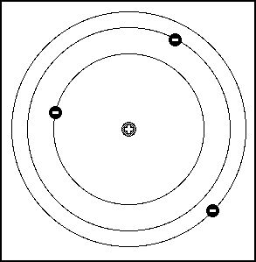
ATOMIC SPECTRA
Bohr stated that electrons live in certain orbits, like the planets. The closer orbits require less energy to maintain electrons within them than the further orbits.
An atom with electrons in its LOWEST energy state (as close to the nucleus as possible) is said to be in the ground state.

Slide 12
ATOMIC SPECTRA
He thought that like rungs on a ladder, electrons could not exist between the levels - just on the levels. Addition of a photon of energy can only move electrons from one energy level to another. This causes the electron to become excited (or, if it absorbs sufficient energy, to escape the atom entirely; we call this ionization).

Slide 13
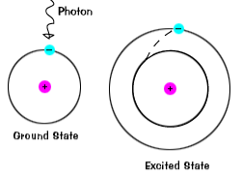
ATOMIC SPECTRA
Addition of energy causes electrons to move to a level that is further away from the nucleus, increasing the potential energy.
Nature, being lazy wants to reduce the energy the atom has (it is more stable). But for the electron to drop to a lower energy level it has to give up some energy.

Slide 14
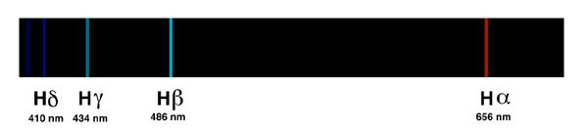
ATOMIC SPECTRA
A jump back toward the nucleus releases energy, that energy is emitted as light. The frequency of that light is dependent on the amount of energy released. These are the bands of light Bohr saw.
E_{photon} = hf
c = λf

Slide 15
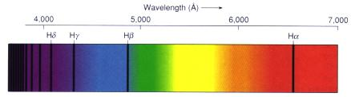
ATOMIC SPECTRA
Dark Hydrogen absorption lines appear against a continuous visual spectrum, the light in the spectrum absorbed by intervening Hydrogen atoms.
From "Astronomy! A Brief Edition," J. B. Kaler, Addison-Wesley, 1997.

Slide 16


ATOMIC SPECTRA
Hydrogen emission spectrum (visible light only):
Hydrogen absorption spectrum (visible light only):

Slide 17
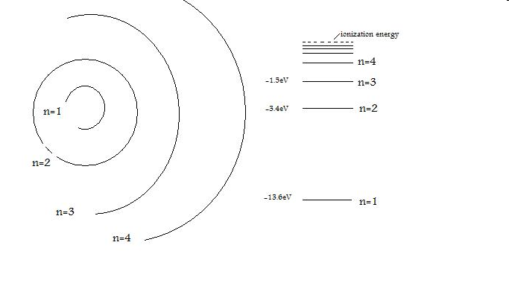
Absorption: photon E = 10.2eV

Slide 18
Absorption: photon E = 12.1eV

Slide 19
Emission: photon E = 10.2 eV

Slide 20
Emission: photon E = 12.1 eV

Slide 21
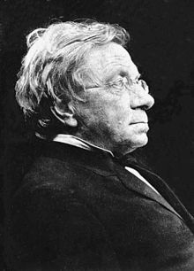
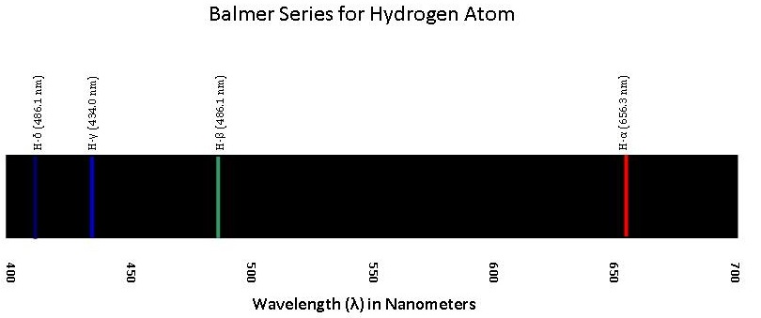
HOW DID BOHR COME ABOUT HIS MODEL..?
In 1855 Johann Balmer derived an empirical formula for a series of Hydrogen emissions in the visible spectrum. These emissions are now known as the Balmer series. Balmer managed to derive a proportional relationship between the wavelengths of these emissions using whole-number integers.
Notes:
chemwiki.ucdavis.edu

Slide 22
HOW DID BOHR COME ABOUT HIS MODEL..?
In the 1880’s, Johannes Rydberg was working on finding a mathematical description of the emission spectra of alkali metals. He realised that his findings correlated with Balmer’s. He derived an empirical equation that relates the wavelengths of the lines in the Hydrogen spectrum:
‘n’ = number of the energy level in the emission spectrum of Hydrogen. This was inferred by Bohr; Rydberg identified the relationship but gave no physical interpretation.

Slide 23
RYDBERG EQUATION: EXAMPLE
What is the wavelength of light emitted when the Hydrogen atom’s energy level changes from n = 4 to n = 2?
Answer: 4.86 x 10⁻⁷ m, or 4.86 x 10² nm.

Slide 24
SERIES
There are other series for Hydrogen besides the Balmer Series:
Lyman Series (n₁ = 1, n₂ = 2,3,4…)
Balmer Series (n₁ = 2, n₂ = 3,4,5…)
Paschen Series (n₁ = 3, n₂ = 4,5,6…)
Brackett Series (n₁ = 4, n₂ = 5,6,7…)
Pfund Series (n₁ = 5, n₂ = 6,7,8…)

Slide 25
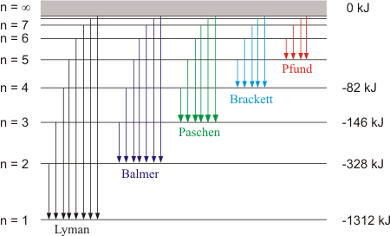
SERIES

Slide 26
HYDROGEN SPECTRAL LINES
Lyman series
(ultraviolet)
Balmer series
(visible)
Paschen series
(infrared)
Frequency
(hertz)
10¹⁶
10¹⁵
10¹⁴
n =
7 6 5 4 3 2 1

Slide 27
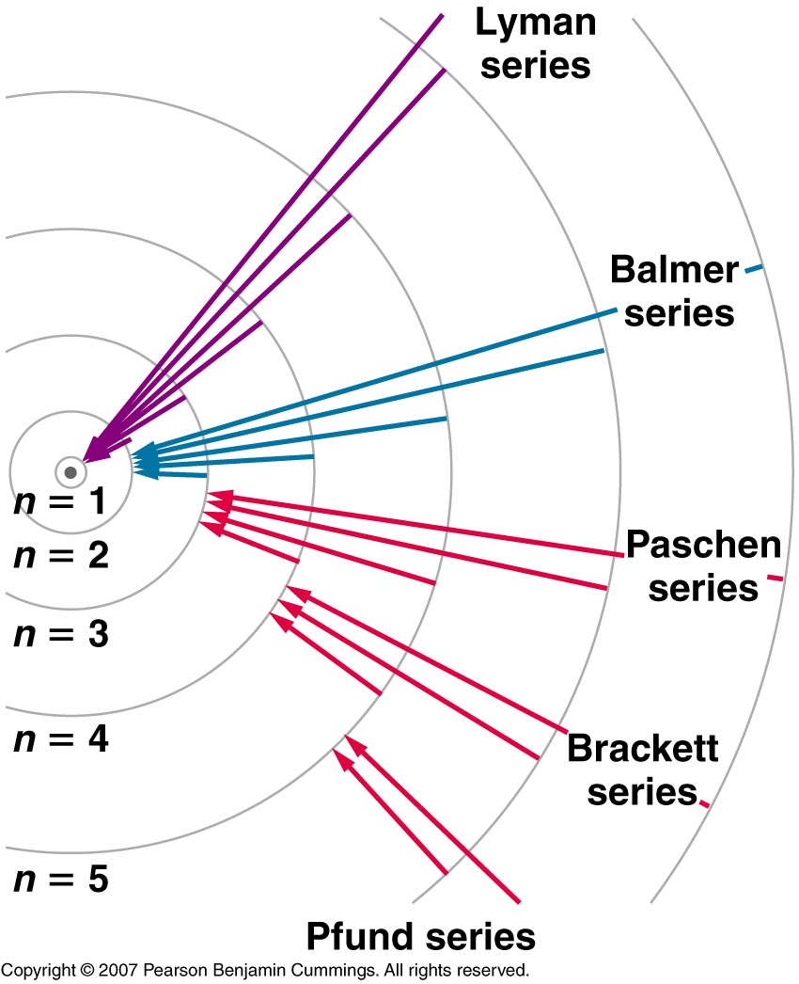
HYDROGEN SPECTRAL LINES
(ultraviolet)
(visible)
(infrared)
Copyright © 2007 Pearson Benjamin Cummings. All rights reserved.

Slide 28
HYDROGEN SPECTRAL LINES
Bohr’s model of the atom accounted mathematically for the energy of each of the transitions shown.
ionization
E₆
IR
region
E₅
656 nm
486 nm
434 nm
410 nm
E₄
E₃
A B C D
Paschen (IR)
E₂
A B C D E
Balmer (Visible)
Energy
UV
region
E₁
A B C D E F
Lyman series (UV)
Davis, Metcalfe, Williams, Castka, Modern Chemistry, 1999, page 97
Notes:
The energy of the light that is emitted from an atom is equal to the difference in energy between the excited state and the ground state. As Bohr predicted, the colors of light indicated by his theory matched those in the line spectrum of hydrogen.
• In 1885, Johann Balmer showed that the frequencies of the lines observed in the visible region of the spectrum of hydrogen fit a simple equation:
ν = constant (1/2² – 1/n²) where n = 2, 4, 5, 6, and these lines are known as the Balmer series.
• Johannes Rydberg restated and expanded Balmer’s result in the Rydberg equation:
ν= ℜ(1/n²₁ – 1/n²₂),
where n₁ and n₂ are integers, n₂ > n₁, and ℜ, the Rydberg constant, has a value of 1.09737 x 10⁷m⁻¹.

Slide 29
NOW TO BOHR YOU WITH THE DETAILS
Using Rydberg’s observations, E = hf and Rutherford’s Planetary Model of the atom, Bohr postulated that the reason electrons could only absorb/emit certain discrete energies is because the angular momentum of the electrons was quantised – that is to say, the angular momentum of an electron had a minimum value, and any larger momentum had to be a scalar multiple of that minimum value.
The minimum value was worked out to be:
nħ
Where…
ħ = h/2π

Slide 30
NOW TO BOHR YOU WITH THE DETAILS
The classical equation for working out the angular momentum of a body in a circular orbit is given thus:
L = mvr
Bohr realised that if angular momentum had to be conserved, then:
mvr = nħ
Solving for r…
r = nħ
mv

Slide 31
NOW TO BOHR YOU WITH THE DETAILS
Solving for r…
r = nħ
mv
This implied that if angular momentum was quantised only certain specific orbital radii would be permissible. This in turn suggested that only certain orbital transitions would be possible – in classical mechanics any amount of energy should have produced a change in electron orbit. However, with this early Quantum interpretation, only discrete energy values could produce such a change… and that is what we observe with Balmer, Rydberg and E = hf.

Slide 32
NOW TO BOHR YOU WITH THE DETAILS
Bohr also showed that the energy in each energy level could be given thus:
E = k
n²
Where ‘k’ is a constant.
Therefore:
hf = E_{f} – E_{i} = k – k = k( 1 – 1 )
n_{f}² n_{i}² n_{f}² n_{i}²

Slide 33
NOW TO BOHR YOU WITH THE DETAILS
This looks a lot like the Rydberg Equation. Bohr was able to show that the constant (k/h) was identical to the Rydberg constant. This was strong evidence for his model, however it only worked for Hydrogen (i.e. atoms of 1 electron).
The upshot of all this? It means that, if we know the frequency of a photon emitted or absorbed by an atom, we can work out the energy difference between the electron shells using E = hf.
To summarise the Bohr Model of the atom…

Slide 34
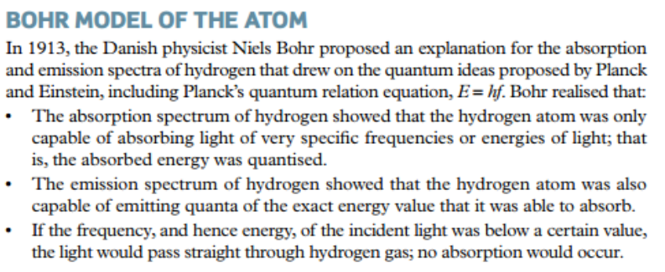

Slide 35
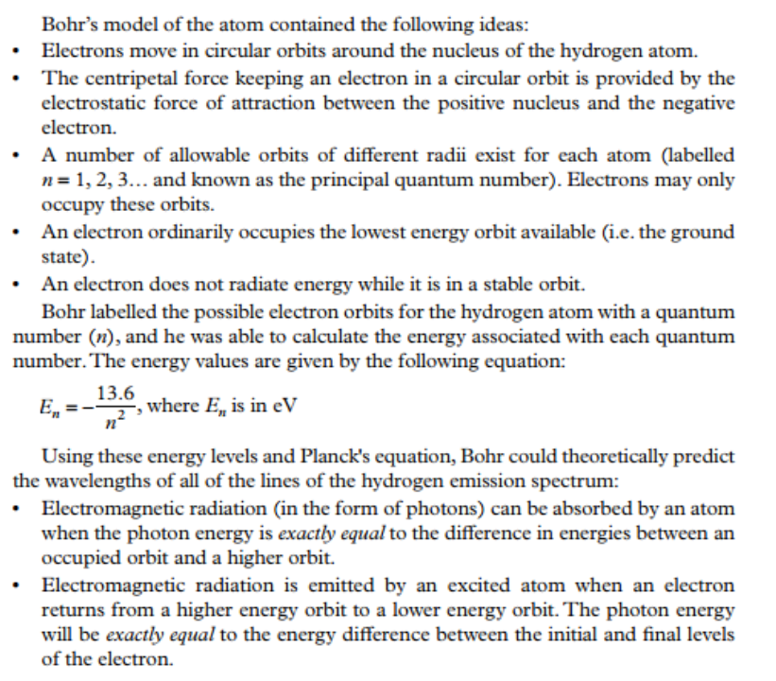

Slide 36
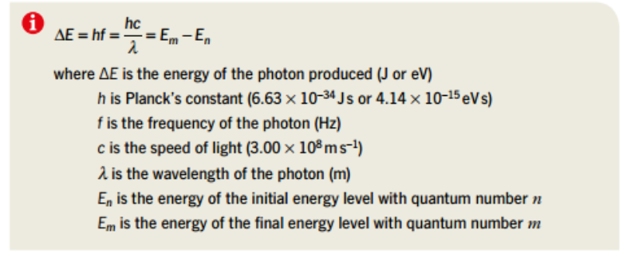

Slide 37
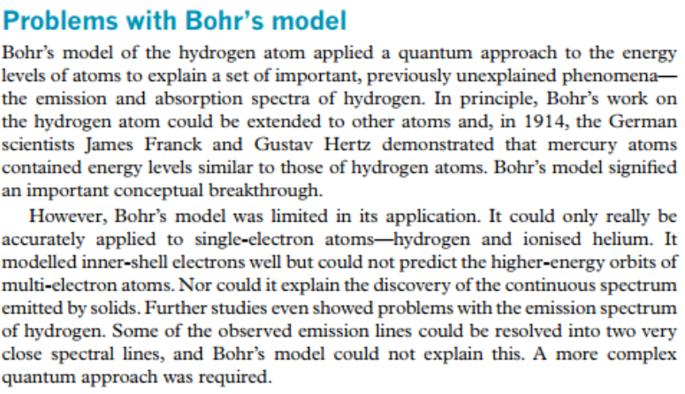

Slide 38
EXPLORING OUR UNIVERSE
Each electron transition (from excited to ground state) emits a photon, and the frequency of the photon depends upon the energy difference between the respective electron shells. The magnitude of this difference varies from element-to-element. This means that we can determine various elements by looking at the photons that they emit (their emission spectra).
Similarly, in order for a photon to be absorbed, it must have exactly the right amount of energy to allow the electron to jump the gap. So, we could also tell an element by the photons that it absorbs (the absorption spectra).

Slide 39
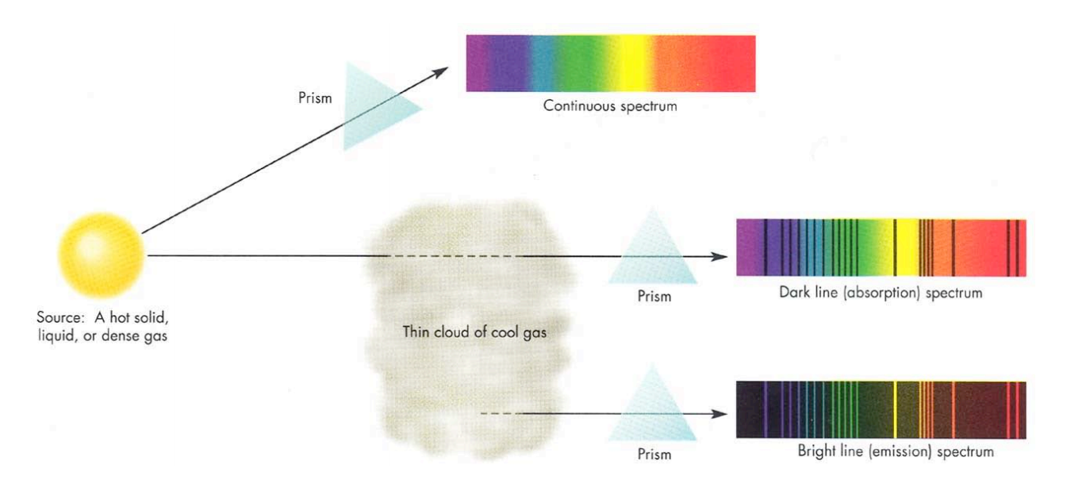
EXPLORING OUR UNIVERSE
The result? We can tell what stars are made of!
Peak λ determined by temperature
Continuous Spectrum with specific wavelengths absorbed out.
Absorbed photons ARE re-emitted, but in all directions, so they tend not to reach the scope.
Blackbody
Comes from hot gas (heat excites electrons) – no external light source.
Notes:
*Book Emission Tubes & Spectroscopes

Slide 40
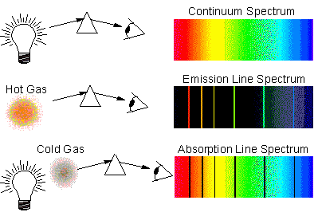
EXPLORING OUR UNIVERSE

Slide 41
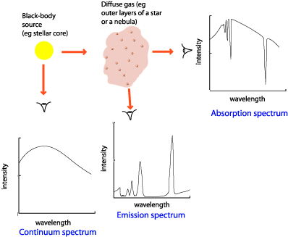
EXPLORING OUR UNIVERSE

Slide 42
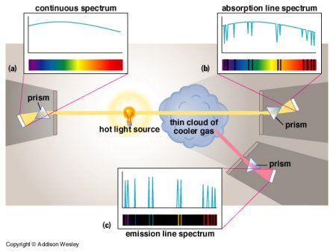
EXPLORING OUR UNIVERSE

Slide 43
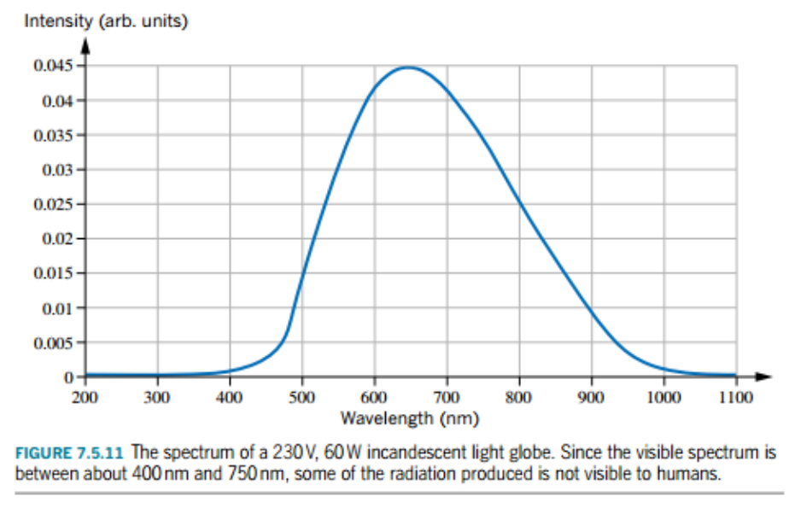
COMPARING DIFFERENT LIGHT SOURCES
As has already been alluded to, it is important to understand that different light-sources will have different emission-spectra, depending largely on how the light is produced.
For example, an incandescent globe relies upon heating a filament (usually tungsten) to a very high temperature. The emission spectra is like that of a blackbody radiator; continuous with a peak wavelength dependent upon temperature.
The thermal motion of free electrons produces electromagnetic radiation with a range of wavelengths, hence a continuous distribution.

Slide 44
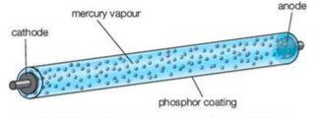
COMPARING DIFFERENT LIGHT SOURCES
A fluorescent light works differently. The tube is filled with gas; depends on the design, but one example might be Mercury vapour. When the light is turned on, the electrons in the vapour are excited by the potential difference between anode and cathode. This releases UV radiation, which is absorbed by a Phosphorous coating on the inside of the tube, and re-emitted as visible light.
Notes:
Emission Spectra – which we can see ourselves with a spectroscope.

Slide 45
COMPARING DIFFERENT LIGHT SOURCES
Something like an LED will not produce a continuous spectrum, as it produces light through the excitation of electrons. The way this occurs is not quite the same as in atoms, so a small range of wavelengths can still be produced; it will therefore produce a (continuous but narrow) emission spectrum.
In the semiconductor diode, most of the electrons sit in the valence band (n-type). If a small amount of (electrical) energy is provided, these electrons can fill holes in the conduction band (p-type), and move through the semiconductor as an electric current. When the electrons eventually drop back to the valence band, they release their energy as photons.

Slide 46
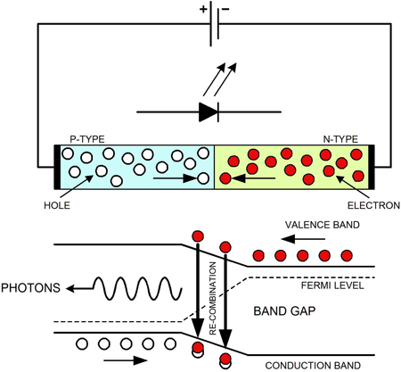
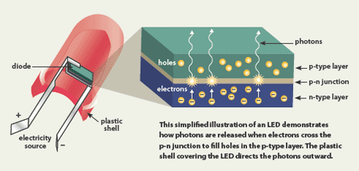
COMPARING DIFFERENT LIGHT SOURCES
Note: Multiple Energy Transitions Possible (over a small range).

Slide 47
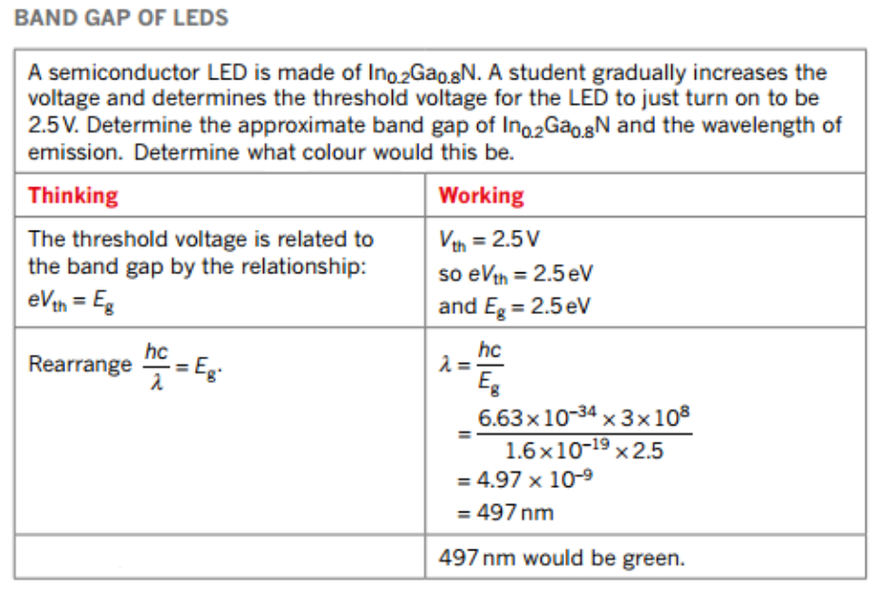

Slide 48
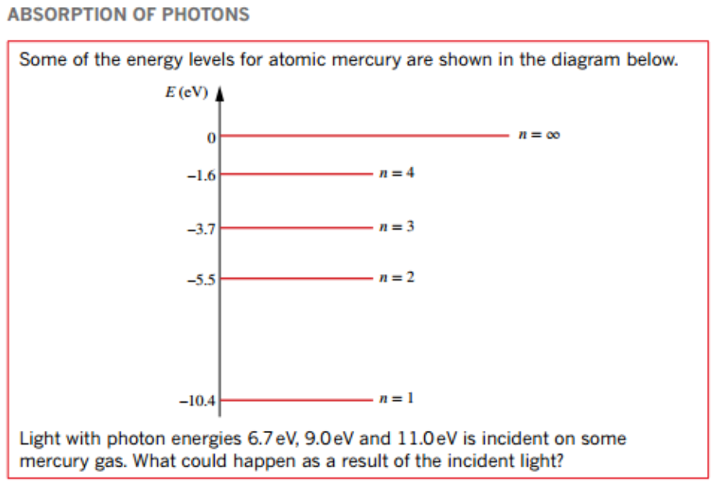
6.7 eV allows n(1→3), all others ionise with KE to spare.
9.0 eV does nothing (incorrect amount – would ionise above n = 2).
11.0 eV ionises all with KE to spare.
What if they each hit electrons in n=2? What are the possible energies for the electron?

Slide 49
Electron could escape with the following kinetic energies:
5.5 eV (if hit by 11.0 eV photon).
3.5 eV (if hit by 9.0 eV photon).
1.2 eV (if hit by 6.7 eV photon).
0 eV (does not escape; there is no certainty that the photon will be absorbed just because it strikes the electron; no absorption = no escape = no KE).

Slide 50
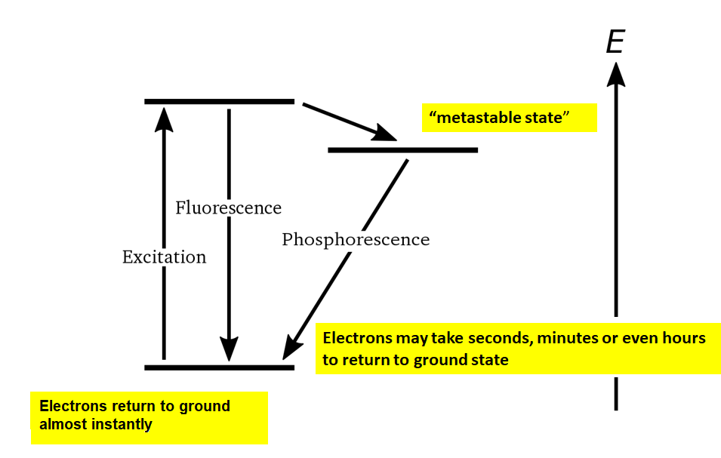
FLUORESCENCE VS. PHOSPHORESCENCE
n = 2
n = 1

Slide 51



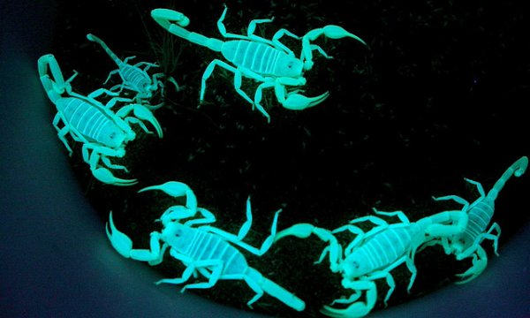


Slide 52
PROPERTIES OF X-RAYS
High penetrating, invisible rays
Electrical neutral-cannot be deflected by electrical and magnetic fields
Liberate minute amount of heat
Causes Fluorescence of certain crystals
Cannot be focused by lens
Affect photographic films
Produce chemical & biological changes by ionization

Slide 53
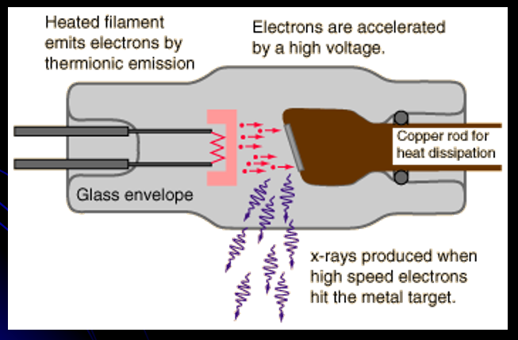
X-RAY PRODUCTION
High energy electrons, accelerated by thousands of kilovolts of potential, interact with a metal target in an x-ray tube.

Slide 54

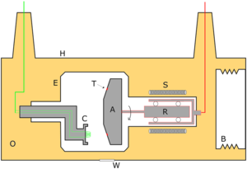
X-RAY TUBE

Slide 55
X-RAY TUBE - CATHODE
Cathode filament is a coiled tungsten wire which is the source of electrons.
Cathode focusing cup to direct electrons to target.
The cathode acts to excite electrons to the point where they become free from their parent atom and are then able to become part of the electron beam.
The cathode acts as a negative electrode and propels the free electrons, in the form of an electron beam, towards the positive electrode (the anode).

Slide 56


Slide 57
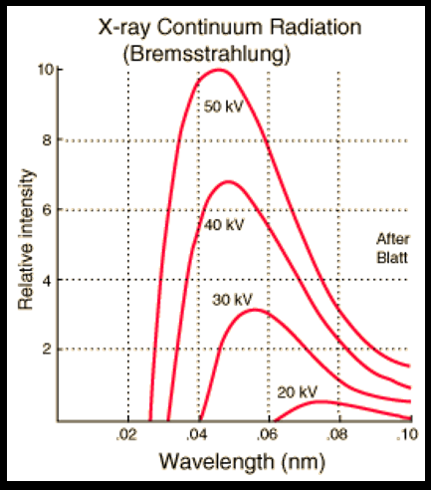
BREMSSTRAHLUNG X-RAYS
Radiation which is emitted when electrons are decelerated or “braked” when they are fired at a metal target.
Accelerated charges give off electromagnetic radiation
When the energy of the bombarding electrons is high enough, that radiation is in the x-ray region of the electromagnetic spectrum.
Bremsstrahlung is characterized by a continuous distribution of radiation.

Slide 58
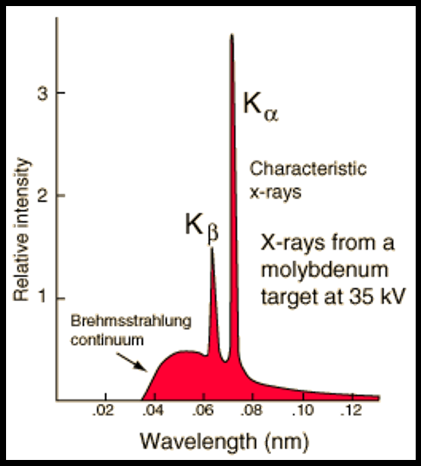
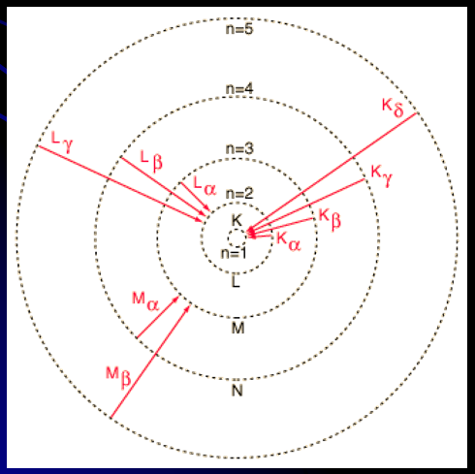
CHARACTERISTIC X-RAYS
Electrons make transitions between lower atomic energy levels in heavy elements. They have definite energies since they have energies determined by the atomic energy levels.
Vacancies are produced in the K-shell of the atom and electrons drop down to fill the gap.
Notes:
Note: the reason for the overlap of X-rays & Gamma Rays on EM spectrum has to do with how they are produced; one is produced visa continuous spectrum, the other by specific electron transitions.

Slide 59
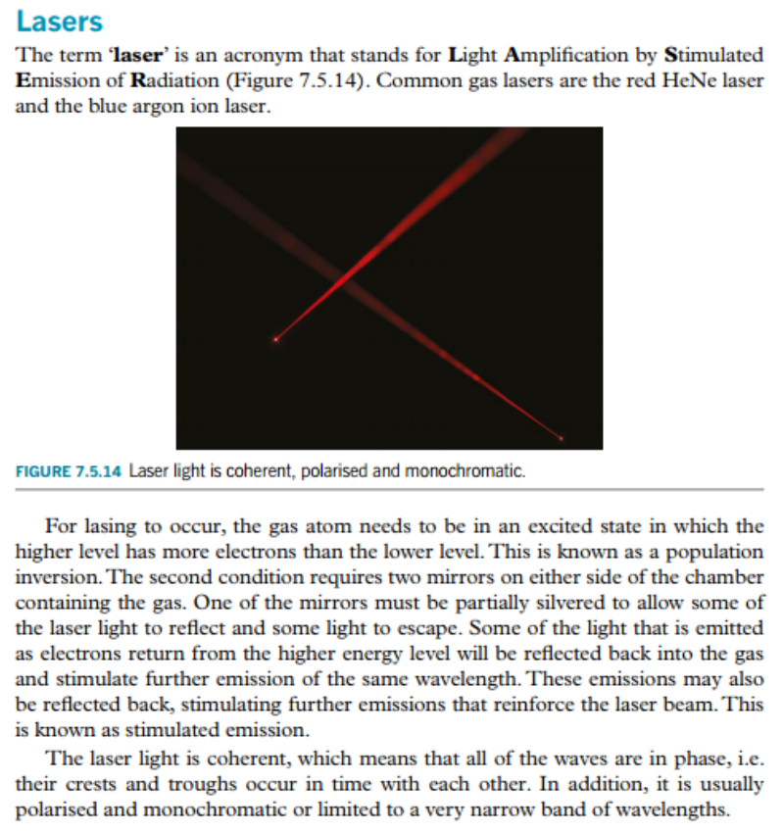
LASER

Slide 60
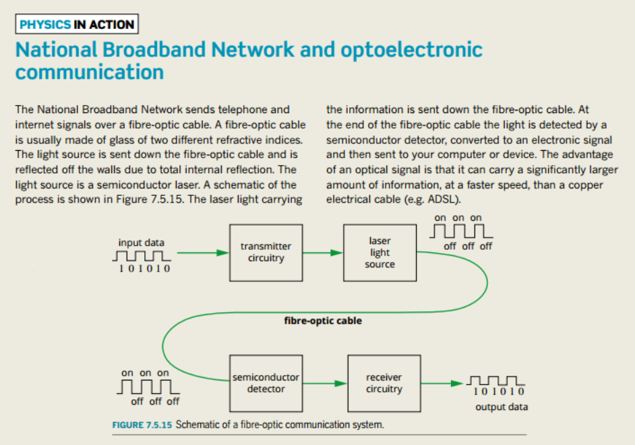

Slide 61

WAVE-PARTICLE DUALITY
The Photoelectric Effect provides us with evidence that photons have particle properties.
This leads us to a question about things we know to be particles – could they perhaps have wave-like properties?

Slide 62
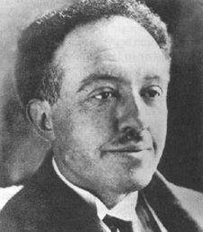
LOUIS DE BROGLIE
Enter Louis de Broglie!
In his 1923 doctoral
dissertation, he postulated
that as photons have both
particle and wave properties,
perhaps this was true for all
matter!

Slide 63
LOUIS DE BROGLIE
It is important to note that de Broglie did not suggest that these waves were
electromagnetic waves –
rather, they were ‘pilot’ waves
that guided matter through
space. He soon set out to
ascertain details about these
‘matter waves’.

Slide 64
DE BROGLIE’S MATTER WAVES
In 1919 Einstein concluded that a photon of energy ‘E’ must have momentum. He even came up with a formula for it.
The formula for the momentum of a particle is:
p = mv
Given that the speed of a photon is the speed of light, we can write the following (never mind that photons are considered to be massless – minor detail apparently!):
p = mc

Slide 65
DE BROGLIE’S MATTER WAVES
p = mc
The energy of the photon can be expressed as E = hf. However, if we are treating it like a particle, we can use E = mc².
E/c = mc²/c = mc = p
If p = E/c, sub. in E = hf:
p = E/c = hf/c
So the momentum of a photon can be given by:
p = hf
c

Slide 66
DE BROGLIE’S MATTER WAVES
De Broglie realised that he could find the associated wavelength of the photon and postulated that it was possible to generalise this expression to all particles:
p = hf = hf
c v
Using v = fλ:
f/v = 1/λ
∴
p = h
λ

Slide 67
DE BROGLIE’S MATTER WAVES
We can also express this as follows:
λ = h = h
p mv
Try the following yourself:
Find the de Broglie wavelength of an electron travelling at 25m/s. Ans: 2.9x10⁻⁵ m
What speed would 160g cricket ball need to travel in order to have the same de Broglie wavelength? Ans: 1.4x10⁻²⁸ m/s

Slide 68
DE BROGLIE’S MATTER WAVES
Why was this important? It is a fundamental law of Physics that energy and momentum are conserved in any interaction. An electron being ejected from a metal via the Photoelectric Effect would be a violation of this unless it was assumed that the photons themselves had momentum which was transferred to the electrons.
This concept also provided an explanation for Bohr’s quantisation of angular momentum.

Slide 69
DE BROGLIE & THE BOHR MODEL
De Broglie hypothesised that the allowed Bohr orbits arise because the electron matter waves interfere constructively when an integral number of wavelengths fits exactly into the circumference of the orbit (like a standing wave!). Therefore:
nλ = 2πr
Substitute λ = h/mv
nh = 2πr
mv

Slide 70
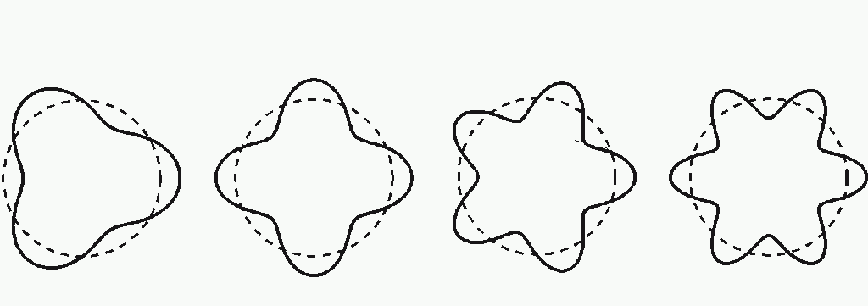
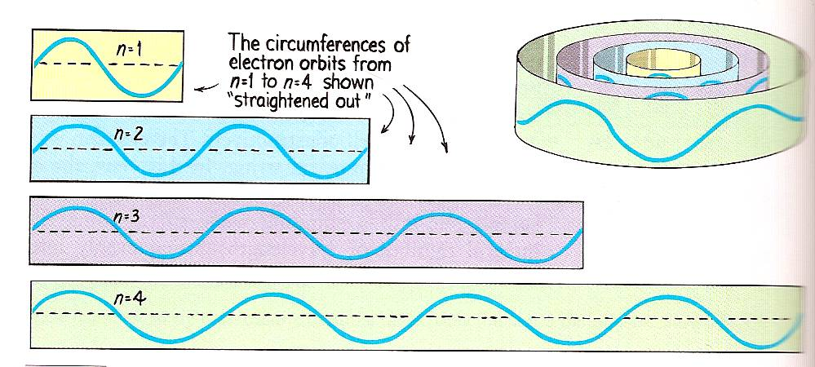
DE BROGLIE & THE BOHR MODEL

Slide 71
DE BROGLIE & THE BOHR MODEL
nh = 2πr
mv
∴
nh = mvr
2π
nħ = L

Slide 72
DAVISSON-GERMER EXPERIMENT
So, what does it mean for a particle to have a wavelength? Does it mean that the particle will oscillate through space? No. In a sense it means that the particle is delocalised (i.e. spread out) in space as it travels.
When a wave travels through an aperture of a similar size to its’ wavelength it will undergo diffraction. If they pass through a slit that is comparable to their wavelength, then they will produce an interference pattern. De Broglie predicted that particles would behave the same way with slits/apertures similar to their de Broglie wavelength.

Slide 73
DAVISSON-GERMER EXPERIMENT
In 1927 Davisson & Germer were doing an experiment to study the surface of a piece of Nickel. The sample of Nickel was mounted inside a vacuum chamber and could be rotated to change the relative angle of the electron beam. During the experiment the vacuum seal leaked and the surface of the Nickel oxidised. To repair the damage they heated the Nickel in a furnace with some Hydrogen gas, and returned to their experiment. To their surprise they now only detected electrons at certain, regularly spaced positions.

Slide 74
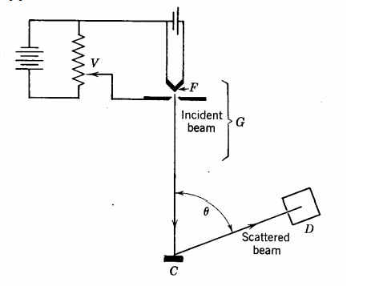
DAVISSON-GERMER EXPERIMENT
Notes:
http://physics.unm.edu/Courses/Fields/Phys491/Notes/DavissonGermer.pdf

Slide 75
DAVISSON-GERMER EXPERIMENT
By heating the Nickel sample it had set into regularly spaced layers. The resulting pattern that was observed was electron diffraction; the electrons had reflected off of the metal to form an interference pattern.
Upon measuring the space between the maxima, they found that it corresponded with the predicted de Broglie wavelength. In short, the layers of Nickel were acting like a series of diffraction gratings for the ‘electron waves’, just like a double-slit experiment performed with thousands of slits.

Slide 76
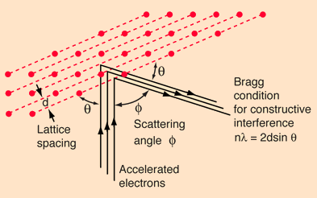
DAVISSON-GERMER EXPERIMENT
Notes:
http://hyperphysics.phy-astr.gsu.edu/hbase/quantum/davger2.html

Slide 77
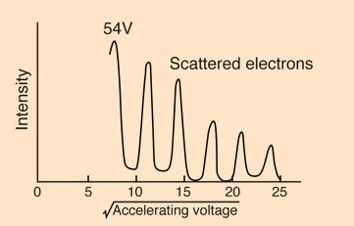

DAVISSON-GERMER EXPERIMENT
θ
Notes:
http://hyperphysics.phy-astr.gsu.edu/hbase/quantum/davger2.html

Slide 78
DAVISSON-GERMER EXPERIMENT
The logic is similar to the logic for the double-slit experiment, with 2 differences – firstly, the angle is measured from the surface and not the normal. Secondly, there is a scale factor of 2 because the electron wave travels the extra distance twice (i.e. there and back again).
This is the condition for constructive interference. For destructive interference, n = (n + ½).

Slide 79
TONOMURA’S INTERFERENCE
In 1989, Akira Tonomura set up a kind of double-slit experiment wherein only one electron at a time could be fired. What he observed was the gradual development of an interference pattern like we have seen before.
This result only makes sense if the single electron somehow passes through both slits simultaneously and interferes with itself (particle theory) or if the electron acts as a wave.

Slide 80
TONOMURA’S INTERFERENCE
Obviously the particle theory here makes no sense, yet an electron is definitely a particle. The conclusion is that the electron wave represents the probability of the electron passing through each slit.
What happens when we know which slit the particle has gone through?

Slide 81
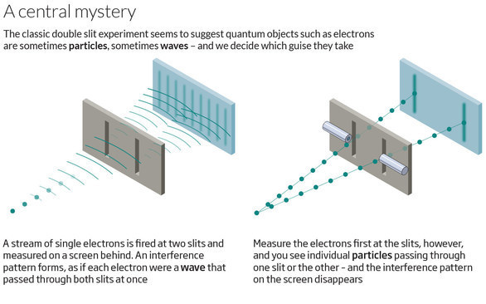
OBSERVER EFFECT

Slide 82

HEISENBERG
The Observer Effect is a complicated one to explain – even for Physicists! One (greatly simplified) explanation involves the particle and its’ motion being described by the Schrödinger Equation. This equation is said to exist in several probabilistic states when unobserved, but will ‘collapse’ to a single state of characteristics upon observation (don’t ask me why).

Slide 83
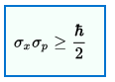
HEISENBERG
Often the Observer Effect is confused with the Heisenberg Uncertainty Principle (even by Heisenberg himself, apparently!).
They are not quite the same - the Heisenberg Uncertainty Principle refers to our inability to accurately measure/know either the momentum or position of a quantum particle past a certain precision (due to reasons of Physics, not limitations of measurement).

Slide 84
THE END!

